Slide 1
Product life cycle (PLC): The life of a product in the market with respect to business/commercial costs and sales measures (On Time and Sales Scales)
Products have a limited life and thus every product has a life cycle
Product sales pass through distinct stages, each posing different challenges, opportunities, and problems to the seller
Products require different marketing, financial, manufacturing, purchasing, and HR strategies at each life cycle stage

Slide 2
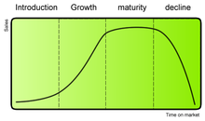

Slide 3
Market introduction stage
High Costs
Low sales volume
Little or no competition
Creation of Demand
Customers prompting to try the product
Makes little money

Slide 4
Growth stage
Costs reduce due to economies of scale
Sales volume increase significantly
Profitability begins to rise
Public awareness increases
Competition begins to increase with a few new players
Increased competition leads to price decrease

Slide 5
Maturity
Costs decrease as a result of high production volumes
Sales volume at peak and market saturation
Increase in competitors entering the market
Prices tend to drop
Brand differentiation and feature diversification is emphasized to maintain or increase market share
Industrial profits decline

Slide 6
Saturation And Decline
Costs become counter-optimal
Sales volume decline
Prices, profitability diminish
Profit becomes more a challenge of production/distribution efficiency than increased sales

Slide 7
Extending the product life cycle
Advertising
Exploring and expanding to new markets
Price reduction:
Adding new features
Packaging
Changing Consumer’s Consumption Habits
Special Promotions: Discounts, Schemes, Offers
Value Add Pointers like eco friendly, cancer free, animal safe,

Slide 8
Features of PLC
Feature | Introduction | Growth | Maturity | Decline
Sales | LOW | High | High | Low
Investment | V. High | High | Low | Low
Competition | Low/ Nil | High | V. High | V. High
Profit | Low | High | High | Low

Slide 9
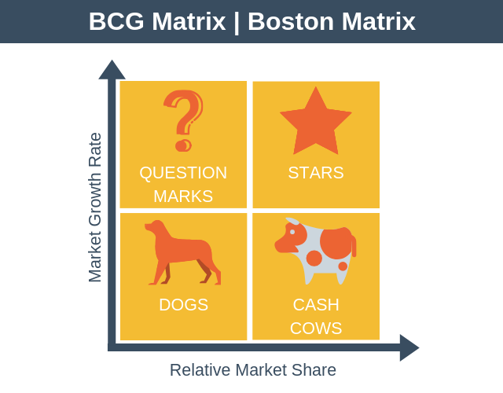
BCG matrix

Slide 10
Boston Consulting Group, USA
2*2 Matrix
Provides a Graphic representation for an Organization
Corporate Portfolio Analysis and Business Classification : Related Market Share and Industry Growth Rate
Comparative Analysis of Business Potential and Evaluation of Environment

Slide 11
How to use the BCG matrix
The BCG matrix is a two-by-two grid that categorizes items as stars, puzzles(Question Mark), cash cows, or dogs. It's a strategy for assessing goods based on growth and relative market share.

Slide 12
Stars Represent Large Market Share in Fast Growing Industry
As market leaders that require significant investment to maintain their market share and competitive advantage.
Stars generate large cash flows, but also consume a lot of cash.
As the market matures, stars can become cash cows.
Stars are a company's most valuable products and are top-of-mind in a firm's product portfolio.

Slide 13
Stars: Products with high market growth and a high market share.
Dogs: Products with low market growth and a low market share.
Cash cows: Products with low market growth but a high market share.
Question mark : Symbolizes a product with a low market share in a high-growth market.

Slide 14
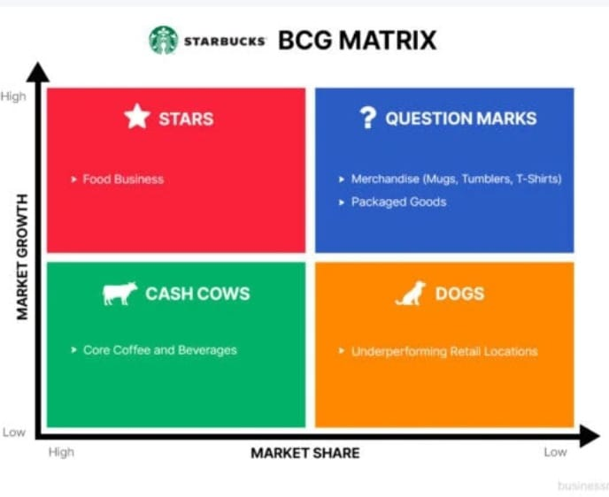
The BCG growth-share matrix

Slide 15
Question marks are also known as "problem children".
They require significant investment to increase market share.
If successful, they can become stars and eventually cash cows.
If unsuccessful, they become dogs when market growth declines.

Slide 16
How to use question marks in the BCG matrix
Analyze question marks carefully to determine if they are worth the investment.
Invest in question marks using cash flows from the cash cow quadrant.
Consider whether to discontinue, develop, or invest in question marks.
Example
Google Glass, Google Home, and Google Stadia are examples of question mark products for Google. These products require significant investment to improve their market position.

Slide 17
BCG matrix purpose
The BCG matrix is a strategic management tool that helps companies analyze their product portfolio. It classifies products into four categories:
stars, cash cows, question marks, and dogs.

Slide 18
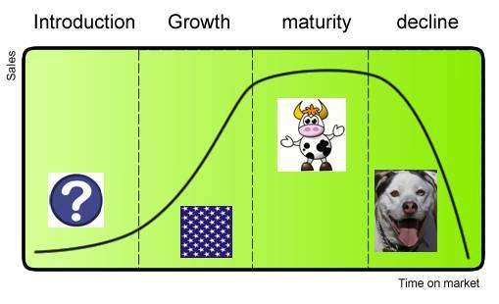

Slide 19
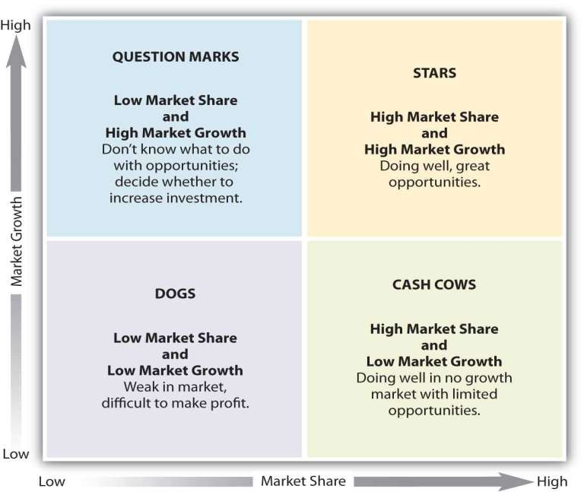

Slide 20
In the BCG Matrix, the "product cycle" refers to the different stages a product goes through in its lifecycle, typically categorized as
"introduction," "growth," "maturity," and "decline,"
which are used to position the product within the matrix based on its market share and market growth rate, allowing companies to analyze its strategic potential within their product portfolio.

Slide 21
Relative market share
This indicates likely cash generation, because the higher the share the more cash will be generated. As a result of 'economies of scale‘. it is assumed that these earnings will grow faster the higher the share
Market growth rate
Rapidly growing in rapidly growing markets, are what organizations strive for; but, as we have seen, the penalty is that they are usually net cash users – they require investment. The reason for this is often because the growth is being 'bought' by the high investment, in the reasonable expectation that a high market share will eventually turn into a sound investment in future profits

Slide 22
Question marks ( high growth, low market share)
Growing rapidly and consumes large amounts of cash But they have low market share.
It has the potential to gain market share and become a star and when the market growth is slow it will become cash cow.
When market growth declines it will be degenerate into dog.
It must be analyzed carefully whether there is worth of investment required to grow market share.

Slide 23
Stars (high growth, high market share)
Generate large amount of cash – market share.
Consumes large amount of cash – market growth.
It will become cash cow when market growth rate declines.
Frequently roughly in balance on net cash flow however if needed any attempt should be made to hold share, because the rewards will be cash cow if market share is kept.

Slide 24
Cash cows ( low growth, high market share)
Generates stable cash flow.
profits and cash generation should be high, and because of the low growth , investment needed to be low. Keep profits high.
Cash cows provide the cash required to turn question marks into market leaders, to cover R&D and to pay dividends to shareholders.

Slide 25
Dogs (low growth, low market share)
Neither generate nor consume a large amount of cash.
Avoid and minimize the number of dogs in a company.
Beware of expensive turn around plans.
Deliver cash, otherwise liquidate.

Slide 26
Limitations of BCG matrix analysis
BCG matrix uses only two dimensions relative market share & market growth rate.
Problem of getting data on market share & market growth.
High market share does not mean profits all time. Business with low market share can be profitable too.

Slide 27
Important to note:
Although BCG matrix has its limitations it is one of the most famous & simple portfolio planning matrix, used by large companies having multi- products.
The BCG matrix does have diverse applications after considering all related aspects of the market.

Slide 28
BCG matrix analysis for Products of Companies

Slide 29
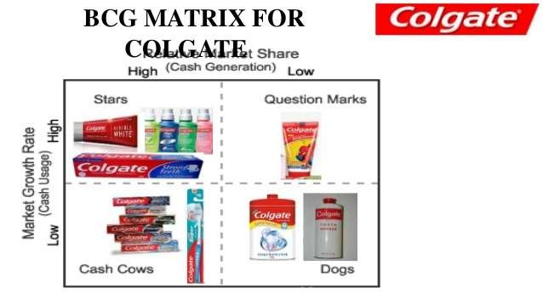

Slide 30
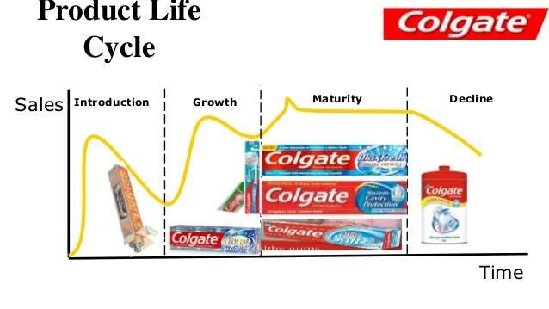

Slide 31
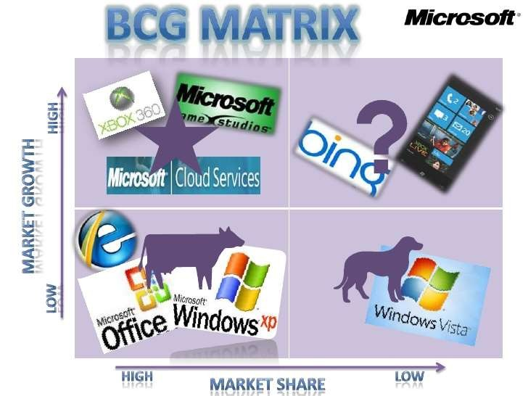

Slide 32
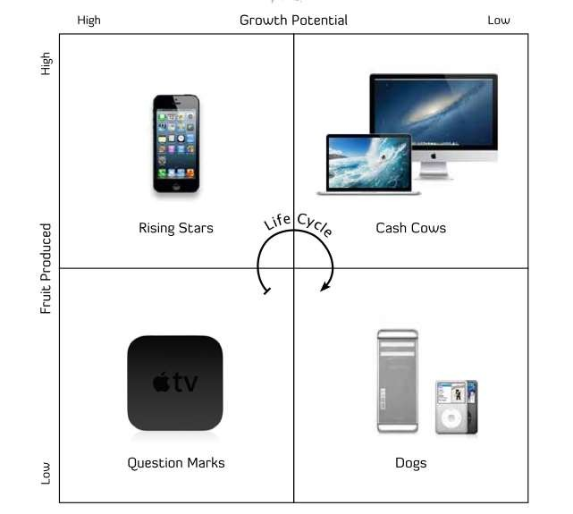

Slide 33
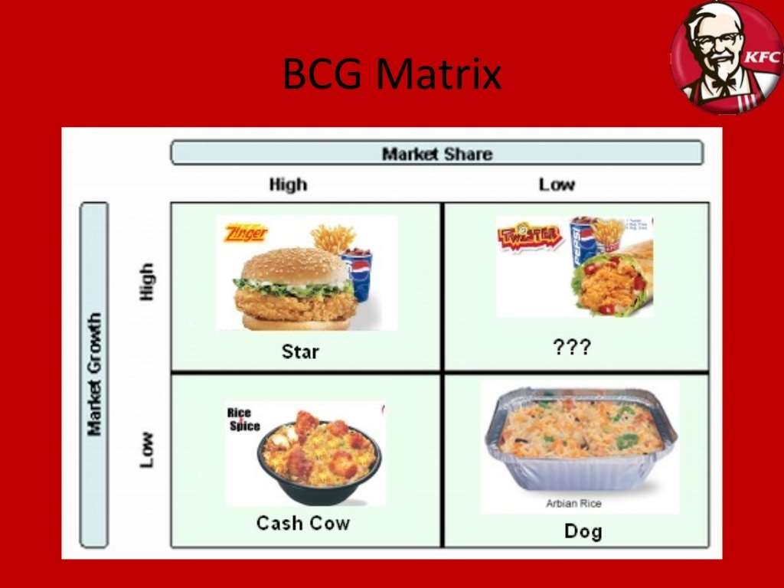

Slide 34
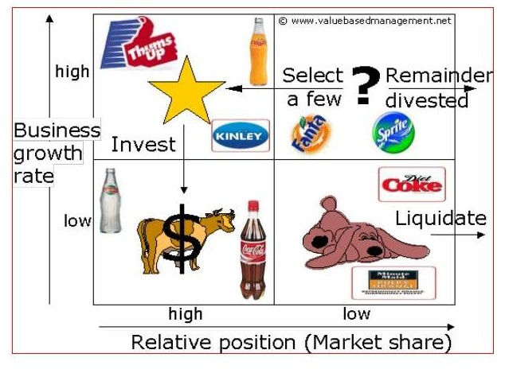

Slide 35
Assignments:
Analyse the performance of :
ITC
Moser Baer
Analysis can be done on overall basis also

Slide 36


Slide 37


Slide 38


Slide 39
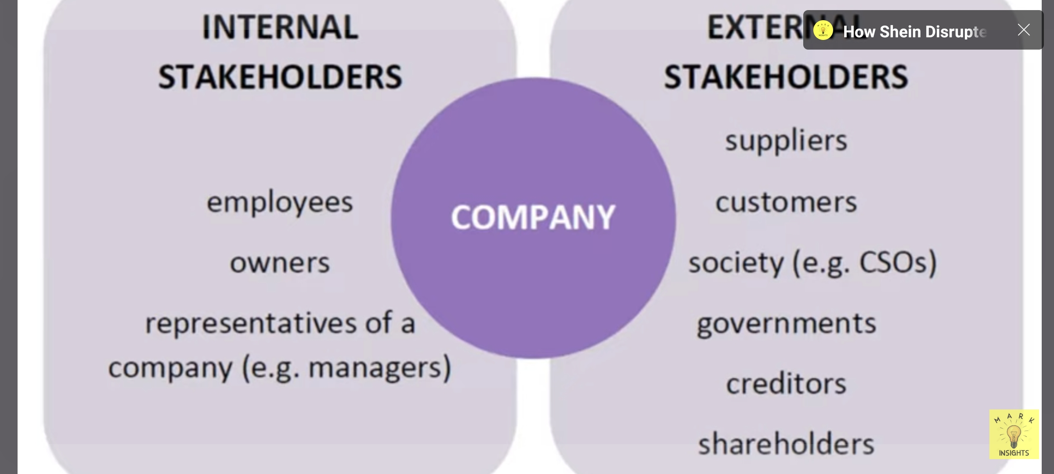

Slide 40
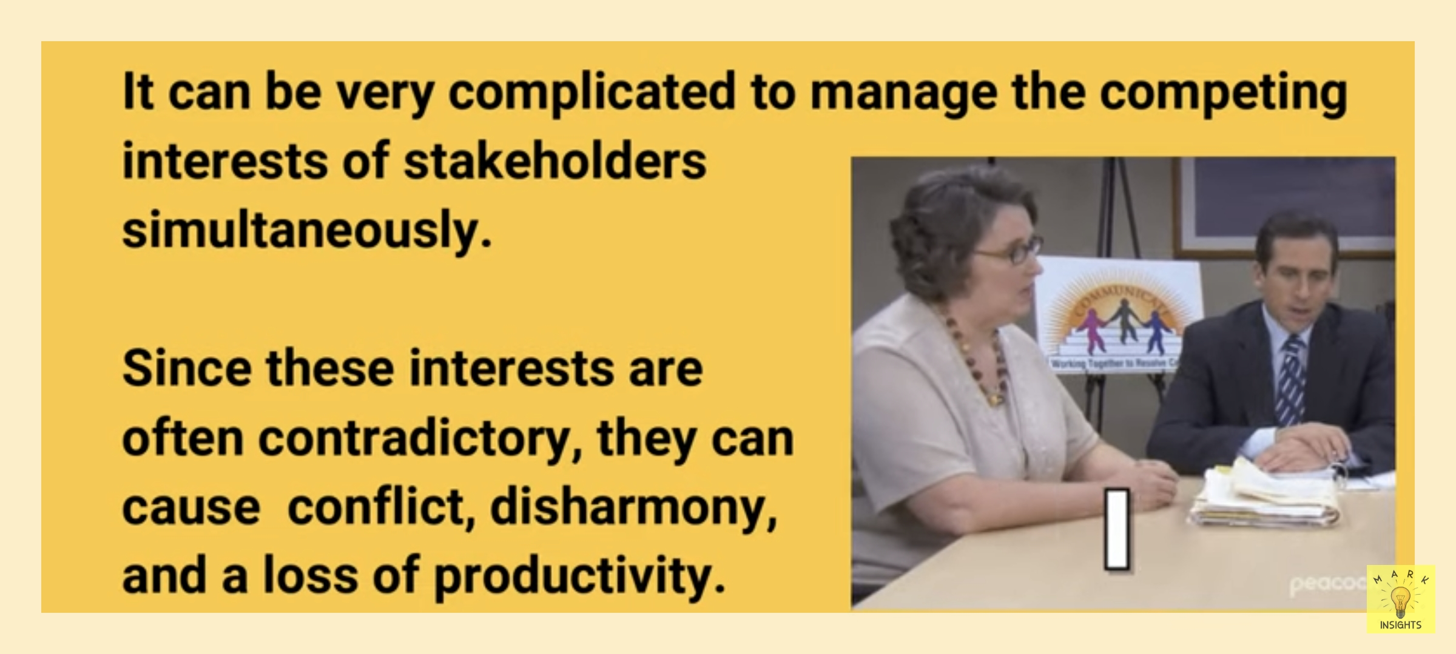

Slide 41


Slide 42
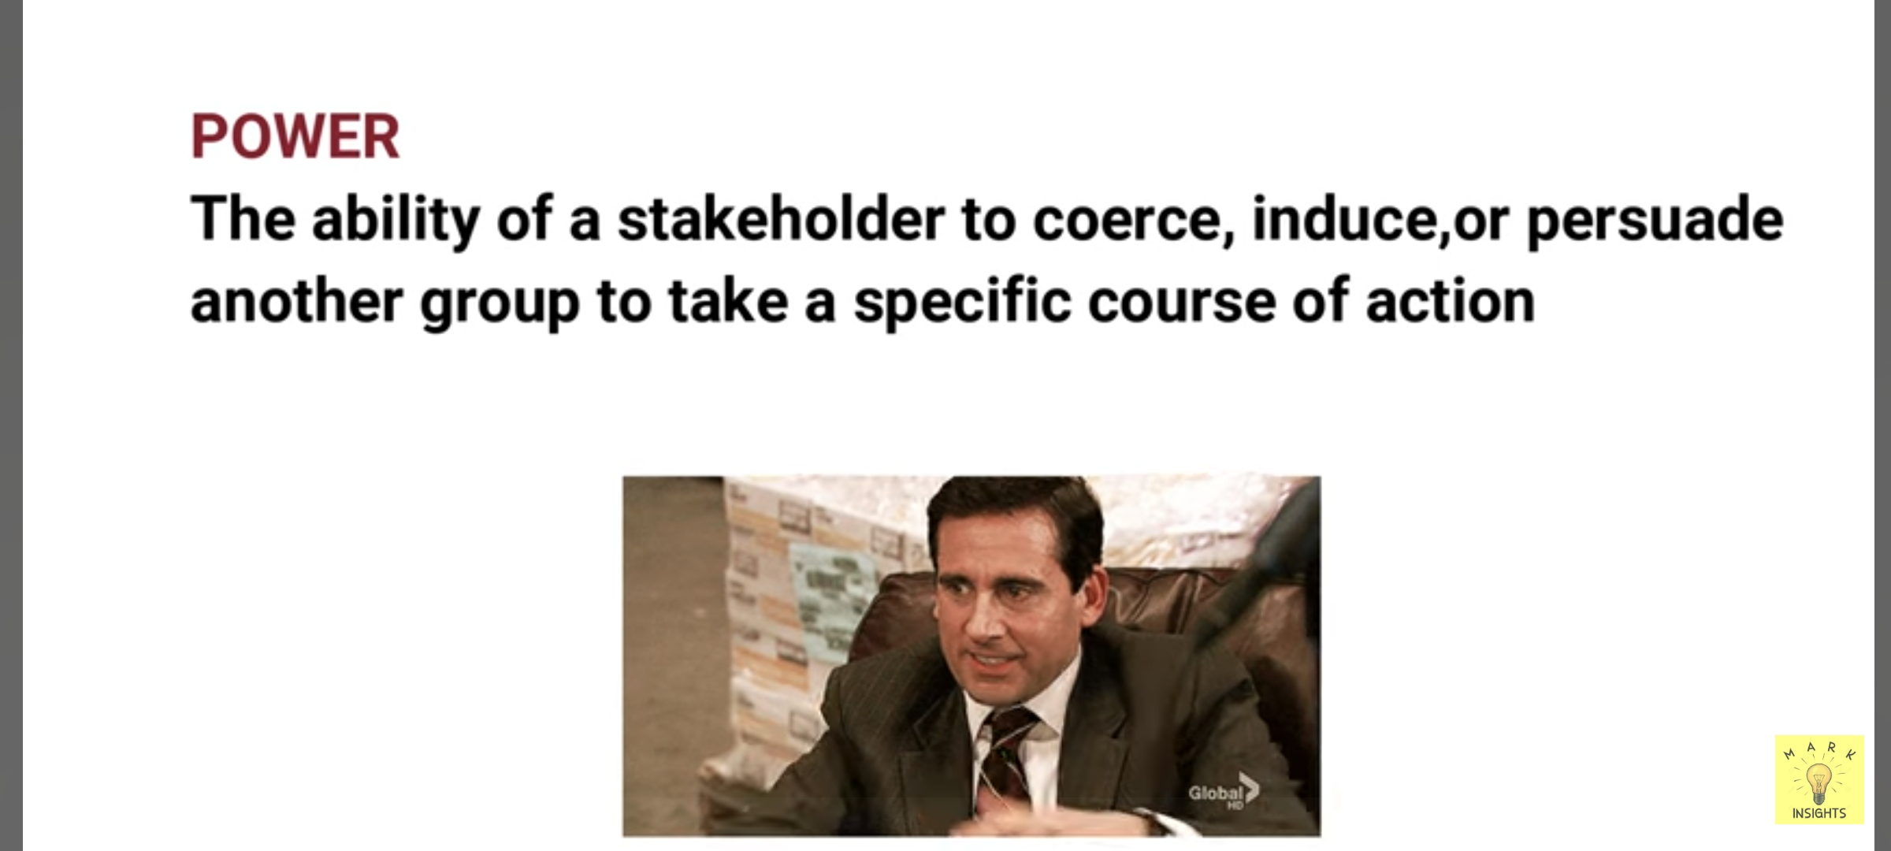

Slide 43


Slide 44
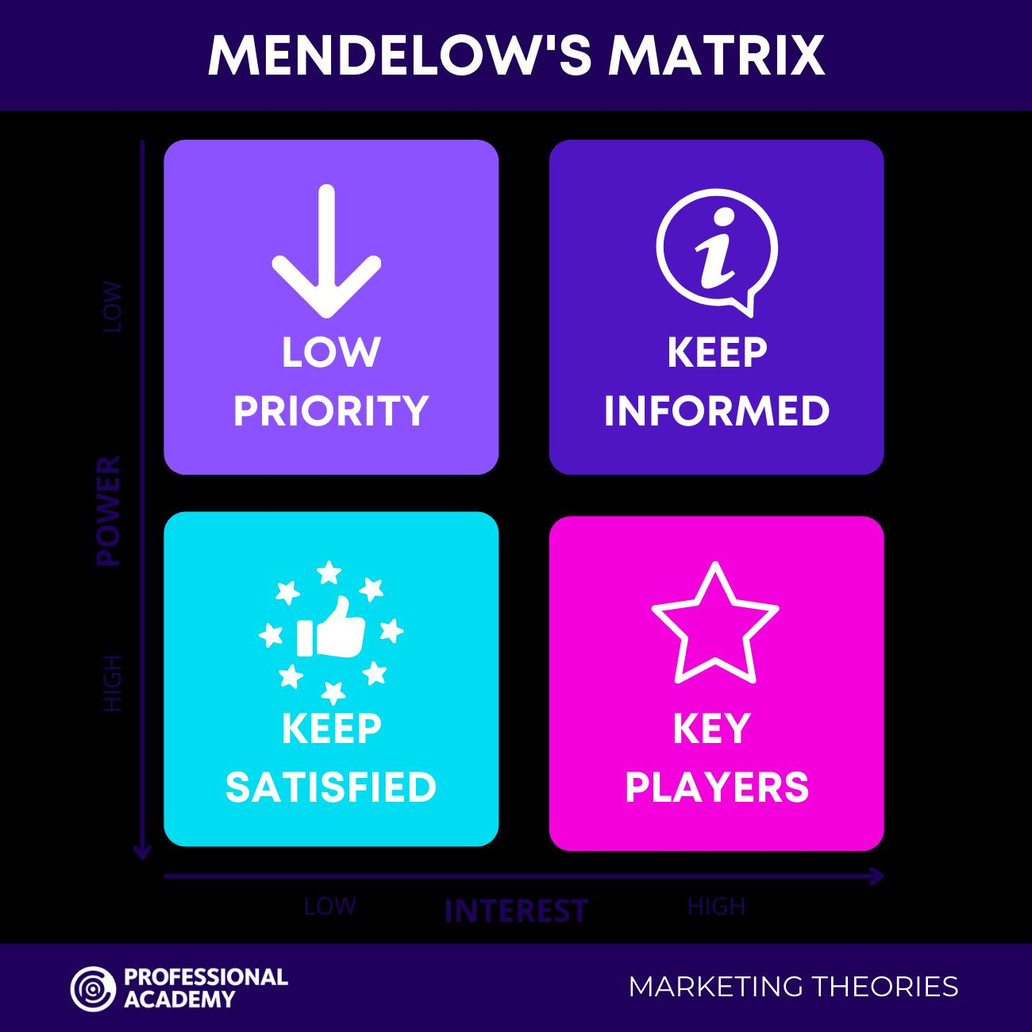

Slide 45
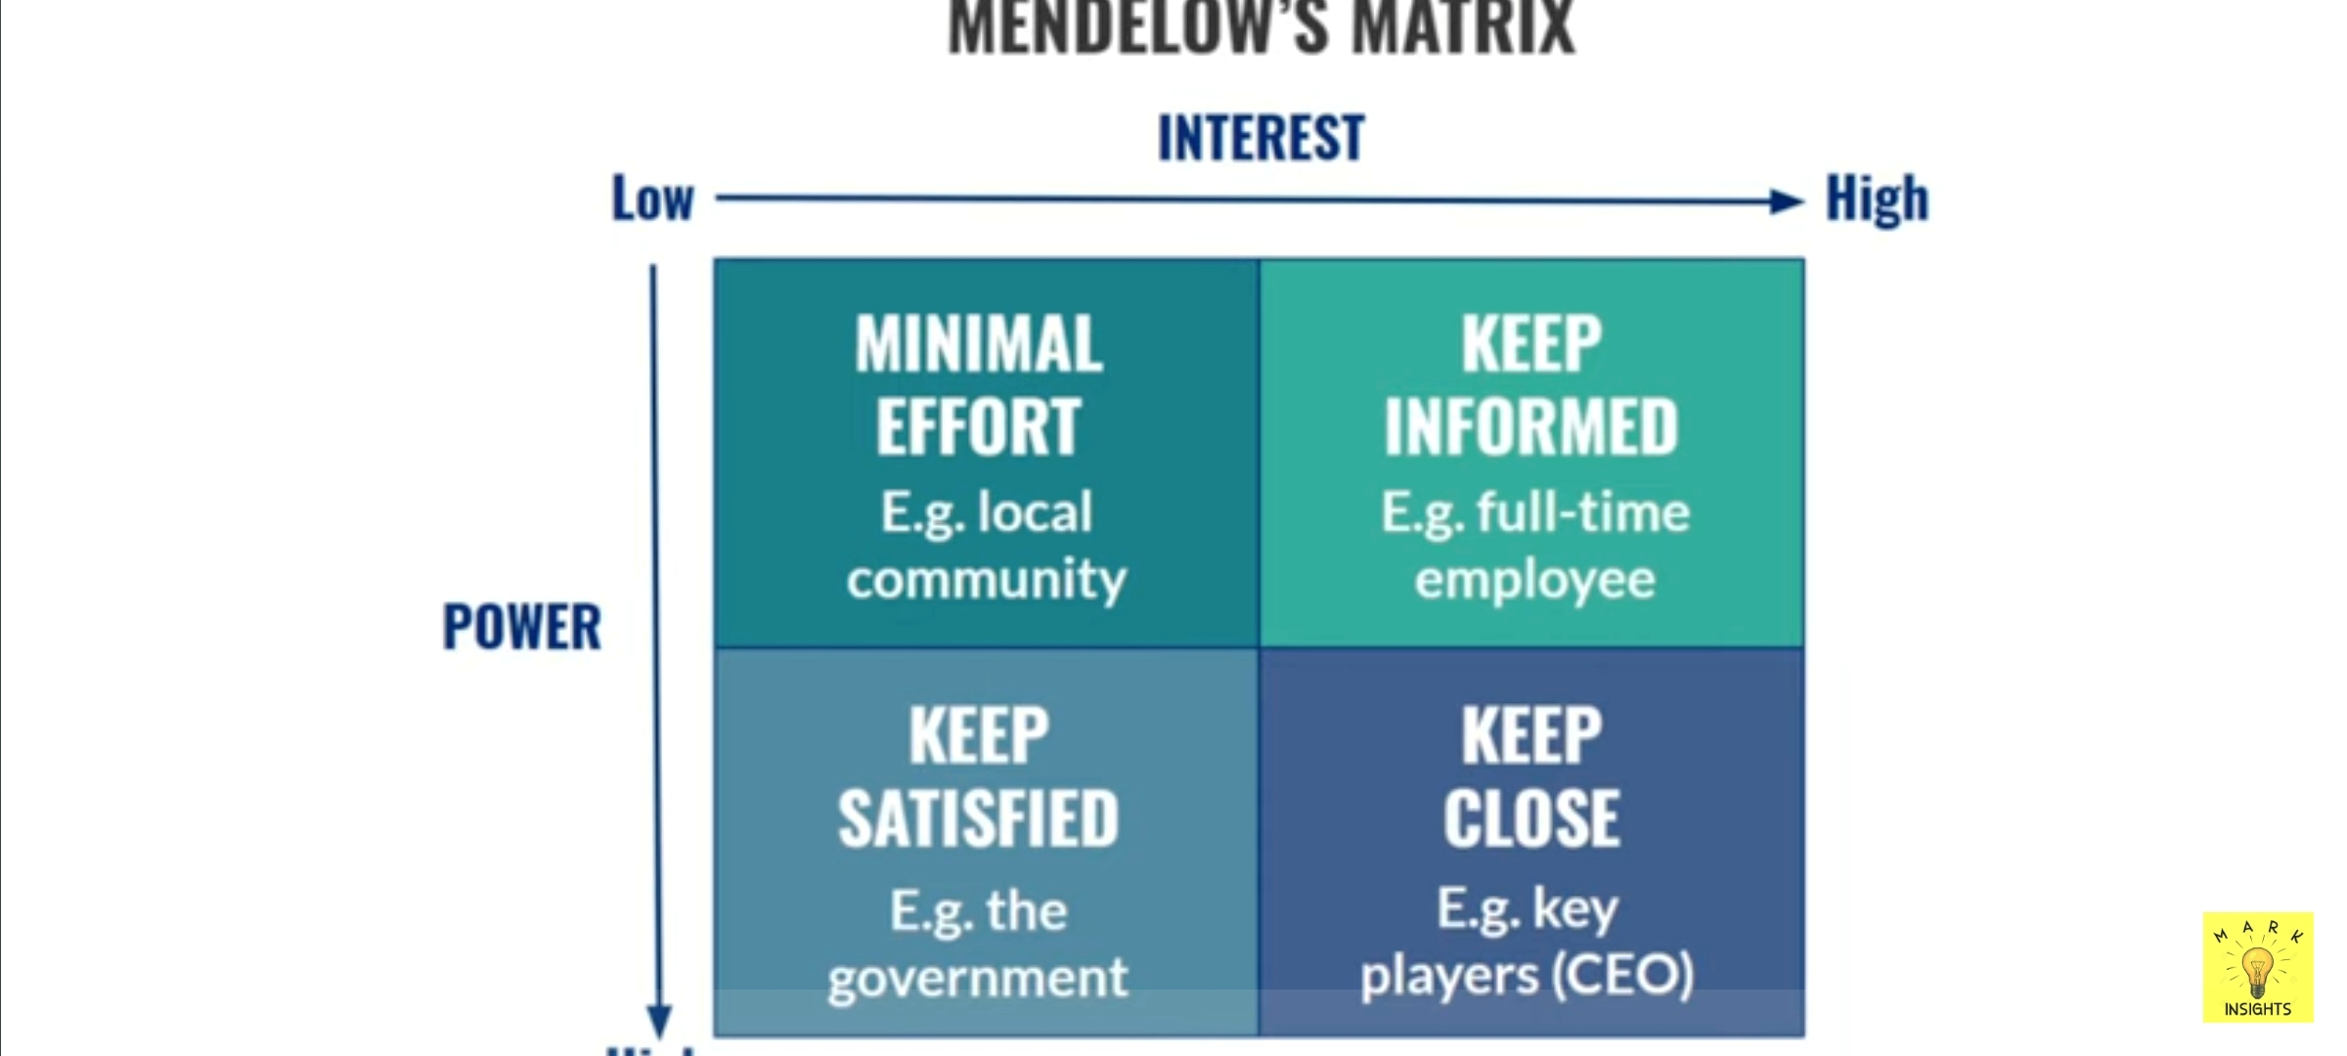

Slide 46
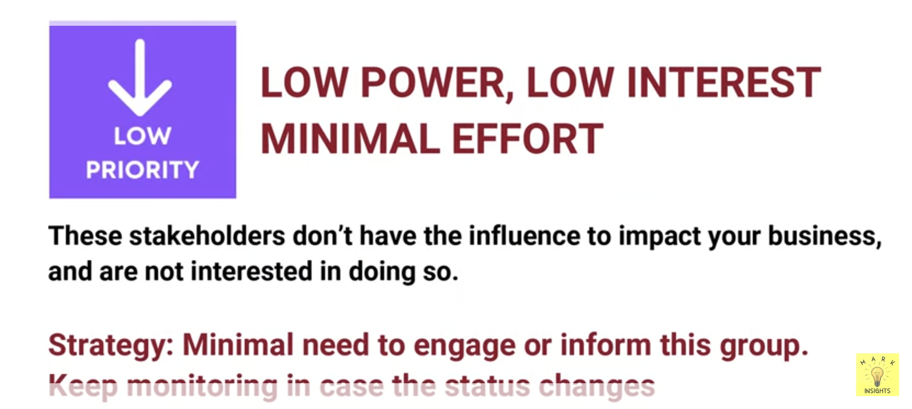

Slide 47


Slide 48


Slide 49


Slide 50
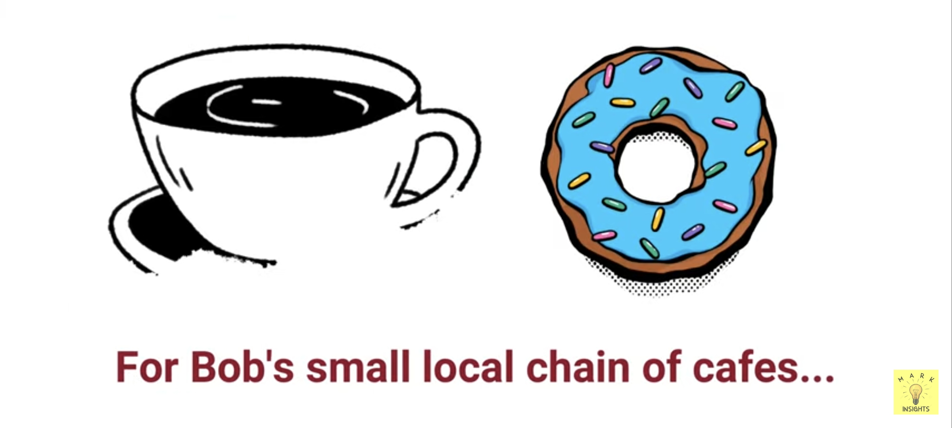

Slide 51
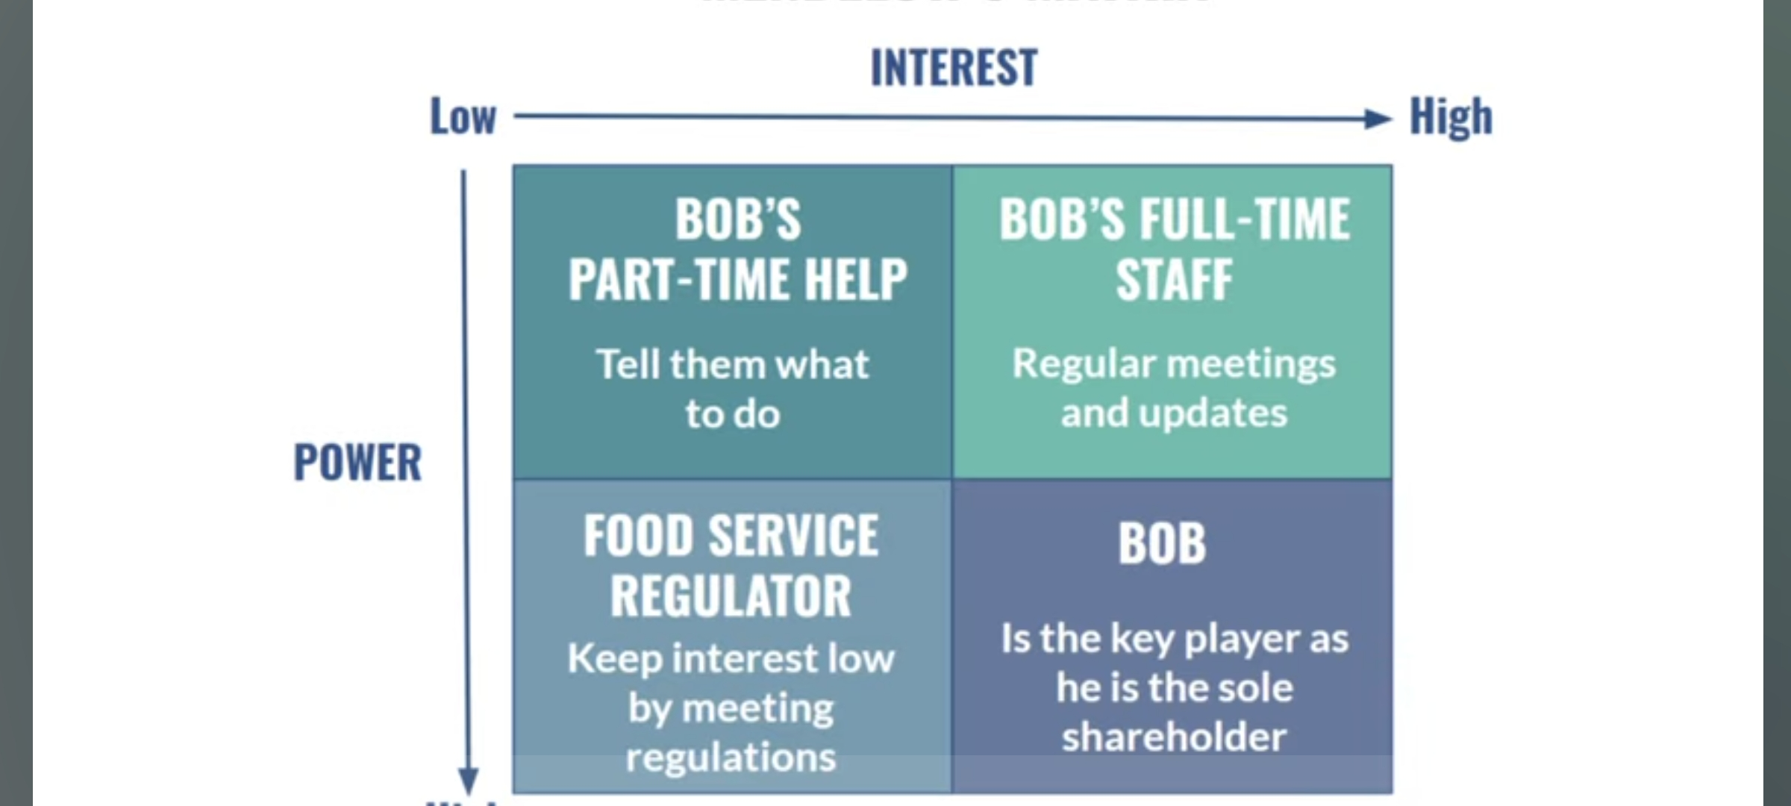

Slide 52
Mendelow’s Matrix

